Slide 1
Action Plan Localisation of SDGs in Odisha

Slide 2
Institutional Mechanism:
State-level SDG Coordination Cell in P&C Department
Project Monitoring Unit (PMU) set up in P&C Department with sector-specific experts to drive SDG momentum in the State: Strategic, Time-bound and Coordinated Efforts
SDG Cells / have been constituted in 37 SDG-Implementing Department of the State
All the District Collectors have formed their District SDG Cells in line with formal letter from DC-cum-ACS focusing on LSDGs.
The District SDG cells consists of one Nodal Officer (PD, DRDA or ADM) and numerous Programme Officers from relevant line departments.
All the three tiers of PRIs and all ULBs of the State -for effective monitoring of SDGs at local level.
The guideline on SoP relating to different thematic goal already issued by P & C as well as PR & DW Deptt.

Slide 3
Implementation Mechanism
State Steering Committee on localisation of SDGs has been constituted
All State-level Nodal Officers selected keeping in mind long tenure of service at least 10 years of Service
PD DRDAs of the Districts declared as Nodal Officers
All stakeholders at the district are part of the District SDG Framework

Slide 4
Implementing Mechanism
Activities | Status | Decisions
Working out KPIs for the 3 Tier PRIs in tune with the PDPs till 2025-26 (FCA) + AAP of Flagship Programs (MGNREGA, SBM, JJM, RH, RURBAN, DDU-GKY, BASUDHA etc) | Dashboard indicators are there to measure the district wise program performance | The State team developing KPIs for GPs in tune with the various program deliverables / indicators.
An Indicative template
KPI | Yes / No | 2022-23 | 2023-24 | 2024-25 | 2025-26 | Remarks
Own GP buildings |  |  |  |  |  | If no, year of completion
100% coverage FHSTW |  |  |  |  |  | If not 100%, Year wise staggering % of coverage to be worked out

Slide 5
OSIF 2.0
Planning & Convergence Department declared as Nodal Department to monitor progress SDGs in the State.
Odisha SDG Indicator Framework (2019) with 367 indicators– To track the progress of SDGs in the State
Currently, OSIF Version 2.0 has been prepared with 292 indicators

Slide 6
Implementing Mechanism Contd…
Activities | Status | Decisions
Convergent Planning, implementation and monitoring at Panchayat level. Accordingly capturing resource envelope of these schemes in the GPDP, BPDP and DPDP | Convergent planning limited to 2 or 3 schemes under GPDP, BPDP & DPDP (Intra- Deptt, not Inter-Deptts) Limited Resource Envelop | Convergence meeting with different line departments to ensure convergence of funds / programmes under GPDP/BPDP/DPDP in addressing issues. To set up GP/ Block / District level targets with measurable indicators having convergence possibilities and resource mobilization. Identifying Nodal Officers of Line Deptts and coordination

Slide 7
Implementing Mechanism Contd…
Activities | Status | Decisions
Clearly laying out Physical and Financial targets in these planning | The Physical & Financial Targets under GPDP / BPDP / DPDP are not based on situational report, sourced from Situational Analysis Report, MA Survey, VRP Survey etc. | Concerned Line Deptts are to attend the meetings of GPDP, BPDP & DPDP at the respective levels for wider consultation for working out physical & financial target through common resource envelop. (Whole of Govt. Approach).
Involvement of different stakeholders including NGOs, INGOs, domain experts | Is under process. | Whole of Society Approach be put in place prior to finalization of Panchayat Development Plan involving all Stakeholders.

Slide 8
Important Circulars
State Level Steering Committee Core Committee for LSDGs | Chaired by Development Commissioner and other Departmental Secretaries | Letter Link
PR & DW Deptt. Core committee | Chaired by Principal Secrteary PR & DW Department along with Directors, Special Secretaries and SDG Cell Officials | Letter Link
One day Orientation on SDG/ LSDGs to PR & DW Department Officials | Chaired by Principal Secretary, Directors, SPl Secretaries, Senior Officials and SDG Cell Officials of PR & DW Deprt. | Letter Link
Sankalp/ AKAM | Issued Instruction to conduct Special Gram Sabh (PR & DW Department) | Letter Link

Slide 9
SDG Budget in Odisha
Odisha SDGs budget represents one of the first attempts at SDGs budgeting in India.
It reflects how the state is approaching for budgeting against the SDGs.
Based on the Odisha SDG Indicator Framework- 2019 and the detailed demand documents of the budget.
Other Budgets: Child Budget
Gender Budget
Nutrition Budget

Slide 10
Details of SDGs mapped to Departmental Programmes and Expenses-2021-22 BE
 | Targets | Indicators (Nos.) |  |  | Schemes-Prog., Admin, TFS, DRF (Nos.)
SDGs |  | Outcome | Output | Process | CS | CSS | DRF | EOM | SSS | TFS | Total*
Goal1 | 7 | 7 | 12 | 10 | 2 | 44 | 0 | 3 | 45 | 9 | 103
Goal2 | 8 | 11 | 11 | 9 | 5 | 39 | 0 | 15 | 95 | 0 | 154
Goal3 | 13 | 14 | 25 | 7 | 4 | 19 | 0 | 5 | 77 | 7 | 112
Goal4 | 10 | 9 | 10 | 8 | 0 | 27 | 0 | 11 | 163 | 0 | 201
Goal5 | 9 | 6 | 15 | 8 | 1 | 23 | 0 | 1 | 22 | 0 | 47
Goal6 | 8 | 6 | 9 | 12 | 2 | 17 | 0 | 4 | 59 | 4 | 86
Goal7 | 5 | 3 | 2 | 0 | 0 | 4 | 0 | 3 | 18 | 0 | 25
Goal8 | 12 | 10 | 19 | 12 | 5 | 13 | 0 | 25 | 122 | 0 | 165
Goal9 | 8 | 3 | 13 | 17 | 0 | 7 | 0 | 14 | 159 | 0 | 180
Goal10 | 10 | 3 | 4 | 4 | 2 | 15 | 0 | 13 | 39 | 0 | 69
Goal11 | 10 | 6 | 4 | 5 | 2 | 9 | 0 | 19 | 39 | 3 | 72
Goal12 | 11 | 1 | 2 | 10 | 2 | 6 | 0 | 2 | 17 | 0 | 27
Goal13 | 5 | 0 | 1 | 7 | 1 | 4 | 17 | 2 | 8 | 0 | 32
Goal14 | 10 | 3 | 4 | 4 | 0 | 13 | 0 | 2 | 13 | 0 | 28
Goal15 | 12 | 6 | 7 | 7 | 1 | 37 | 0 | 3 | 40 | 0 | 81
Goal16 | 12 | 12 | 5 | 4 | 9 | 15 | 0 | 23 | 48 | 0 | 95
Total | 150 | 100 | 143 | 124 | 36 | 292 | 17 | 145 | 964 | 23 | 1477

Slide 11
Monitoring Mechanism and Incentivisation
Activities | Status | Decisions
Capturing Data for various local indicators on Quarterly basis | An indicative data capture framework proposed in the EG Report. State PMU at P & C Deptt are working on it | Constitution of monitoring committee and Capturing of data after finalization of indicators may be worked out by PR & DW Deptt at respective Scheme Officer level.
Integration of monitoring parameters of different schemes into SDG Dashboard for monitoring | State PMU at P & C Deptt are working on it | Being developed at State level
Approach on different mechanisms of incentivization of Panchayats for excellence in localization of SDGs through attainment of different themes | Current State Panchayat incentive / award guidelines are being revised. Revamped RGSA has provisioned for such awards on best performance of 9 thematic goals at MoPR, GoI level from the year 2022-23 | The State incentive / award guidelines may be revised to accommodate such awards w.e.f 2022-23 Evaluation of performance based on achievements in indicators relating to thematic areas. Innovation practices to be documented / local champions to be honoured.

Slide 12
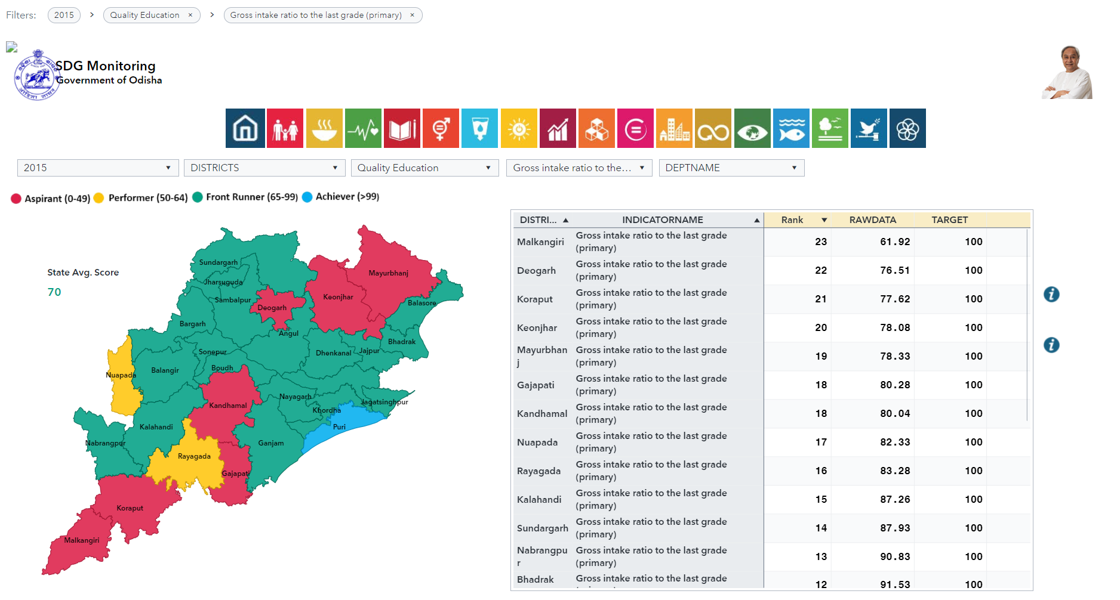
Monitoring Mechanism
Goal & Indicator level analysis with filter capabilities.

Slide 13
Capacity Building & Training
Activities | Status | Decisions
Training Manual in local language developed by SIRD&PR with help of NIRDPR / INGOs/ Centre of Excellence | The Training Modules are being worked out by MoPR. Child Friendly Panchayat, Good Governance and Engendered Development thematic Modules are being developed by SIRD&PR | Being developed by SIRD&PR taking cue from MoPR modules.
SIRD&PR to prepare theme wise adequate no of Master Trainers and other trainers. | Master Trainers have been prepared and Planned for 2022-23 by SIRD&PR and P&C Dept. | This is being provisioned for the year 2022-23 for creating pool of around 5 to 10 Trainers per district.
Through Training and IEC material from different departmental related to their schemes, involvement of domain experts and academic institutions | 9 thematic posters and each thematic objectives and mapping up of schemes officials in Odia have been attempted at SIRD&PR level. A chapter on Panchayat relevant SDGs was included in Panchayat Sahayika Pustika –A Resource book for ERs. Training programmes of officials of District / Blocks/ERs on thematic SDGs organised at SIRD&PR | To be scaled up across the state. PR & DW and P&C Dept. Project Director by P & C Dept. Addl PD, District Panchayat Officers, Asst. Project Director (Trg) and District Project Manager (RGSA) were oriented on LSDG by SIRD&PR.

Slide 14
Capacity Building & Training Contd…
Activities | Status | Decisions
Dissemination and Documentation of Best Practices with implementation strategies of GPs and other relevant stakeholders on different thematic areas | Best Practices and Success Stories on 9 thematic goals are available in MoPR website. Villages with self-sufficient infrastructure / Child Friendly GP thematic success stories of Odisha are also available in MoPR website. | Need to be worked out by SIRD&PR by engaging I & PR empanelled agency for documentation of such success stories in consultation with PD, DRDAs
Creation of a pool of Beacon Leaders/Local Champions on different thematic areas and its relevant SDGs | SIRD&PR have identified around 50 nos. of PRI Leaders whose service may be availed as Beacon Leaders / Local Champions | This need to be scaled up even among the grassroots officials with proven track record in the implementation of schemes at respective levels.

Slide 15
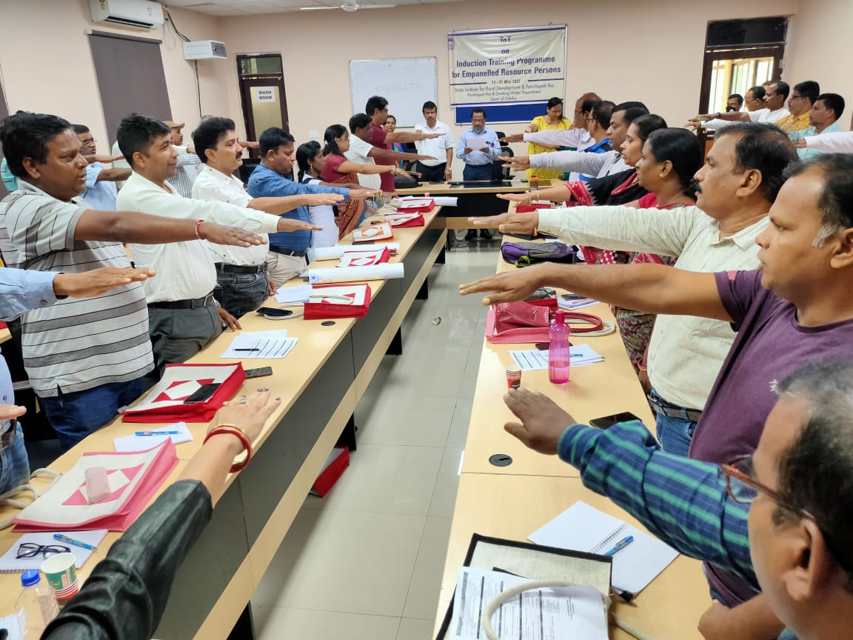
Capacity Building
Addl. PD, District Panchayat Officer, Asst. Project Director (Trg),DPM(RGSA) (40 officers has been nominated as Master Trainer for 9 thematic areas.
Mentoring 9 themes - 5 Gram Panchayts has been assigned to each Instructors / Faculties of SIRD&PR, ETC, DPRC also APD(Trg) & DPM(RGSA).

Slide 16
Way Forward
Preparation of Vision document
Preparation of Baseline report along with SDG/LSDGs Index
Preparation of District Indicator Framework & also relocating LIF of MoPR, GoI.
District level training programmes
District-Level Consultative Workshops
Evidence Based planning
Thematic Working Groups

Slide 17
Vision & Road Map
Activities | Status | Decisions
Vision for 2030 (2022-23 to 2029-30) | PDPs at respect level focusing only on FC Grant and 1 or 2 PR & DW Deptt Schemes (LSDGs) | Whole of Govt Approach required by involving various Deptts while preparing PDP and Schematic Annual Action Plan. Thematic saturated approach be built into PDPs.

Slide 18
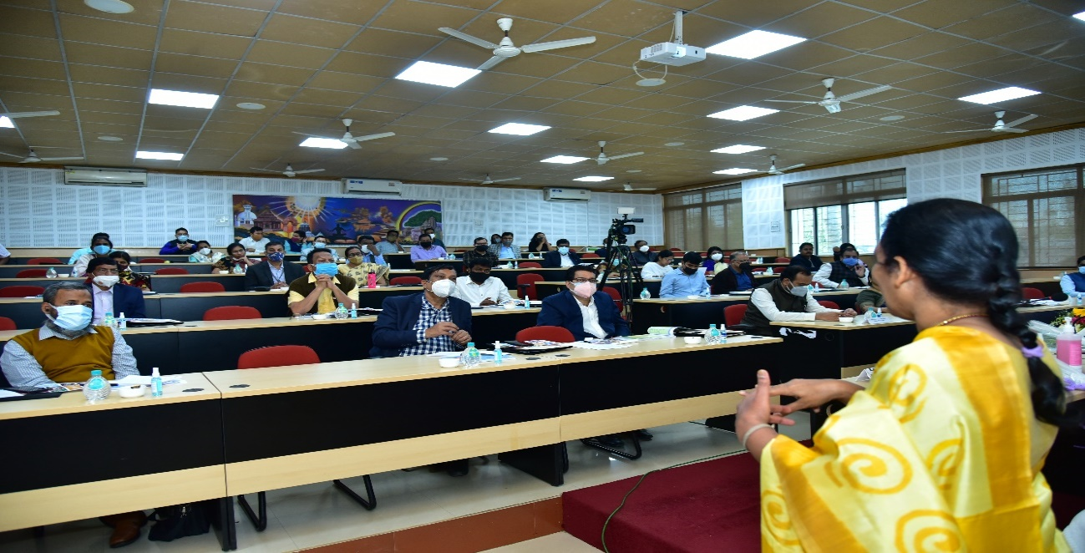
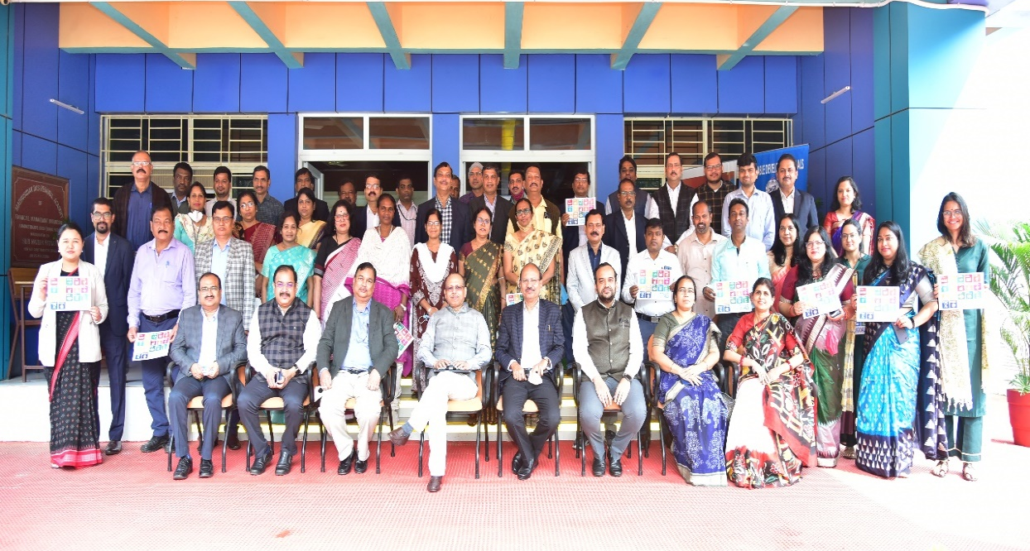
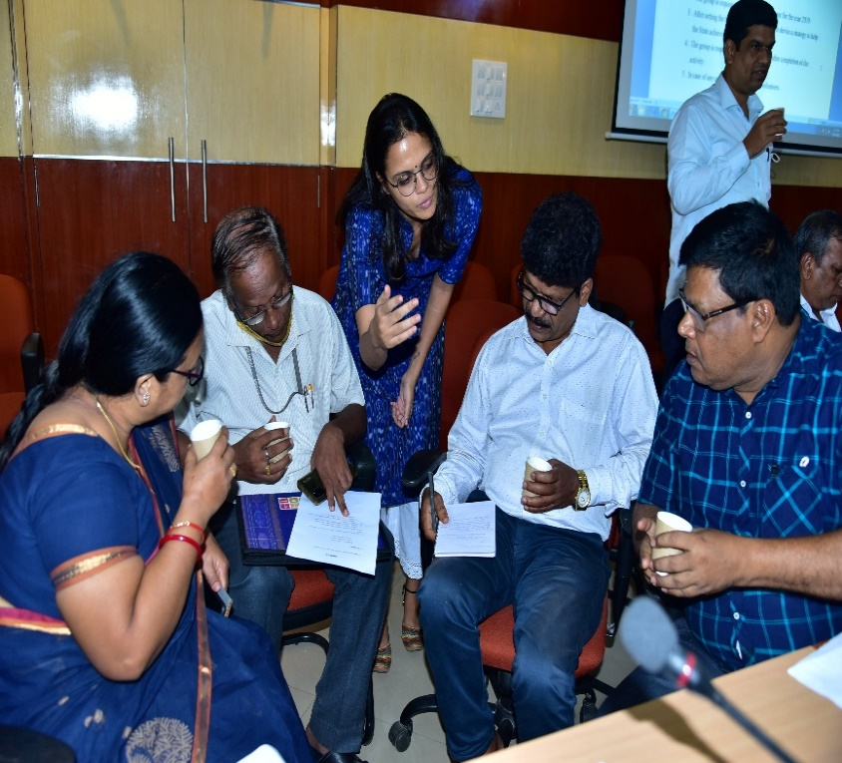
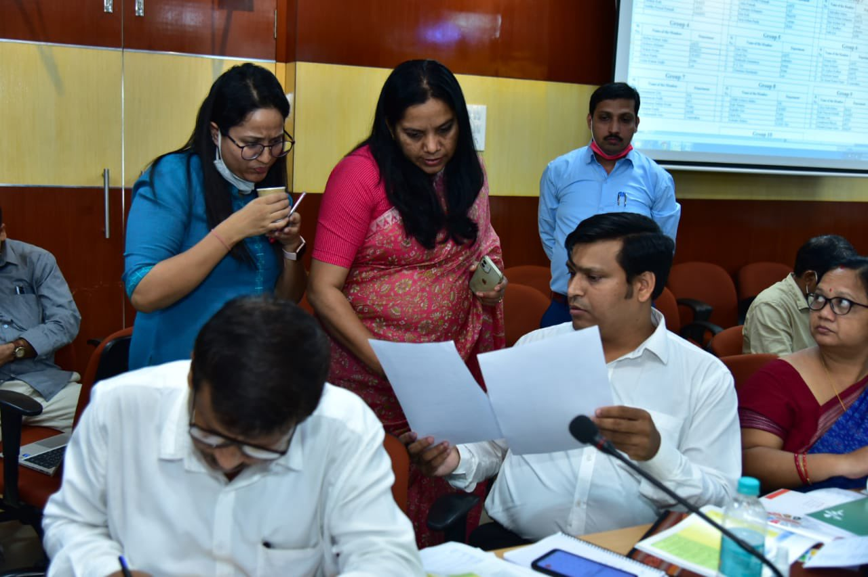
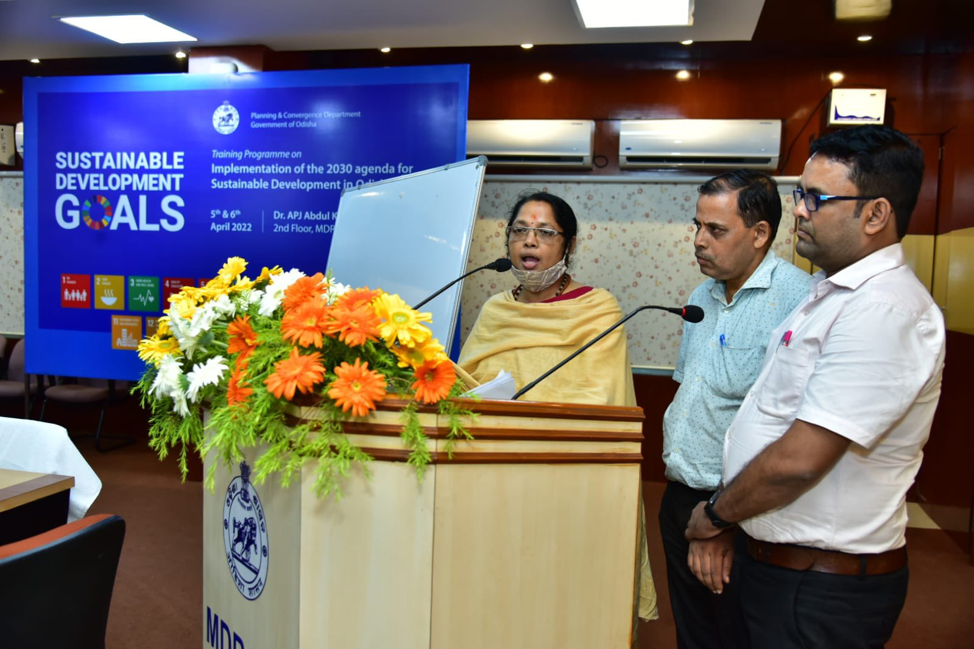

Slide 19
Your valued Feedback Please !!

